Slide 1
Removing unwanted noise from real scene image using GAN
Created by:
A.KASTHOORI
RegNo:912321104013
Naanmudhalvan ID:au912321104013
III - year, CSE
SACS MAVMM ENGINEERING COLLEGE,
MADURAI.

Slide 2
Project outline:
Problem statement
Proposed system/solution
System development approach
Algorithm and deployment
Result
Reference
Conclusion

Slide 3
Problem statement:
The task is to develop a Generative Adversarial Network (GAN) model capable of removing unwanted noise from real scene images.
However, many of these images suffer from various types of noise, such as Gaussian noise, salt-and-pepper noise, and speckle noise, which degrade the visual quality and impede downstream image processing tasks

Slide 4
Proposed system/solution:
We propose to address the problem of noise removal from real scene images using a GAN-based approach. The proposed model will consist of a generator network responsible for denoising input images and a discriminator network trained to distinguish between clean and denoised images.
1.Data Collection and Preprocessing:
Collect a dataset of real scene images with various types and levels of noise. These images can include Gaussian noise, salt-and-pepper noise, speckle noise, etc.
Preprocess the images by resizing them to a standard size and normalizing pixel values.

Slide 5
Proposed system/solution:(contd..)
2. Architecture Selection:
Choose an appropriate GAN architecture for image denoising. Popular choices include Deep Convolutional GANs (DCGAN), Wasserstein GANs (WGAN), or Progressive GANs (PGAN).
3. Training:
Train the GAN on the collected dataset. During training, the generator learns to produce denoised versions of noisy images, while the discriminator learns to distinguish between clean and denoised images.

Slide 6
Proposed system/solution:(contd..)
4.Evaluation:
Evaluate the trained GAN on a separate validation dataset to assess its performance in denoising real sceneimages.Quantitatively Measure denoising performance usingmetrics such as Peak Signal-to-Noise Ratio (PSNR) and
Structural Similarity Index(SSIM).
5.Deployment:
Once the GAN has been trained and evaluated satisfactorily, deploy it for denoising real scene images in practical applications.

Slide 7
System Development Approach:
To develop a system for removing unwanted noise from real scene images using a GAN (Generative Adversarial Network), you'll need to follow a systematic approach. Here's a step-by-step guide.
Problem Definition:
Clearly define the types of noise present in your real scene images and specify the desired level of noise reduction.Determine the target platform or application where the denoising system will be deployed.
Dataset Splitting:
Split the dataset into training, validation, and testing sets. Typically, you would allocate a larger portion of the data for training and smaller portions for validation and testing.

Slide 8
System Development Approach:(contd..)
Model Training:
Implement the chosen GAN architecture using a deep learning framework like TensorFlow or PyTorch. Train the GAN on the training dataset using appropriate loss functions, such as pixel-wise mean squared error (MSE) loss or adversarial loss.
Model Evaluation:
Visualize denoised images alongside their corresponding clean versions to assess the perceptual quality of the results. Fine-tune the model based on validation results and iterate on the training process if necessary.
Testing :
Assess the performance of the trained model on the testing set to ensure generalization to unseen data.

Slide 9
Algorithm and deployment:
Problem statement:
Identify whether the real scene images is noisy or not.
Input:
The real scene images.
Output:
The primary objective of denoising using GANs is to reduce or eliminate unwanted noise from the real scene images.

Slide 10
Algorithm steps:
Preprocessing:
Preprocess the images if necessary
(e.g., resize, normalize pixel values).
Loss Function:
Define the loss function for the GAN. Typically, it includes:
Adversarial loss: Measures how well the generator fools the discriminator.
Perceptual loss: Measures the difference in content between the generated clean images and the real clean images.

Slide 11
Algorithm steps:(contd..)
Inference:
Deploy the trained model to remove noise from new real scene images. Input the noisy images into the generator and obtain the cleaned images as output.
Post-processing:
Optionally, perform additional post-processing steps such as denoising filters or refinement techniques to further enhance the quality of the cleaned images.
Iterative Improvement (Optional):
If the results are not satisfactory, consider iterative improvement by refining the GAN architecture, adjusting hyperparameters or collecting more diverse training data.

Slide 12
Deployment steps:
Model Optimization:
Before deployment, optimize the trained denoising GAN model for inference. This may involve techniques such as model pruning, quantization, or compression to reduce its size and computational requirements while maintaining performance.
Framework Selection:
Choose a deep learning framework suitable for deployment, such as TensorFlow Lite, TensorFlow.js, PyTorch Mobile, or ONNX Runtime, depending on the target platform (e.g., mobile devices, web browsers, edge devices).

Slide 13
Deployment steps:(contd..)
Model Conversion:
Convert the trained GAN model to a format compatible with the chosen deployment framework. This may involve exporting the model to ONNX format or converting it to the framework-specific format.
Quality Assurance:
Perform rigorous testing and validation of the deployed denoising model to ensure its correctness, robustness, and reliability in real-world scenarios. Evaluate the denoising performance on diverse datasets and under various conditions to assess its effectiveness.

Slide 14
Deployment steps:(contd..)
Monitoring and Maintenance:
Implement monitoring mechanisms to track the performance of the deployed denoising model over time. Monitor key metrics such as iInference latency, throughput, and accuracy to detect any deviations from expected behavior.
Security and Privacy Considerations:
Address security and privacy concerns related to the deployment of the denoising model, such as data confidentiality, model robustness against adversarial attacks, and compliance with regulations (e.g., GDPR, HIPAA).

Slide 15
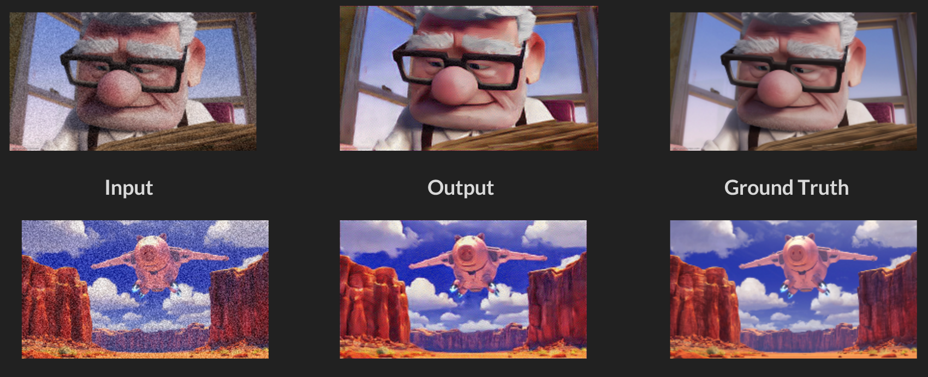
Result:

Slide 16
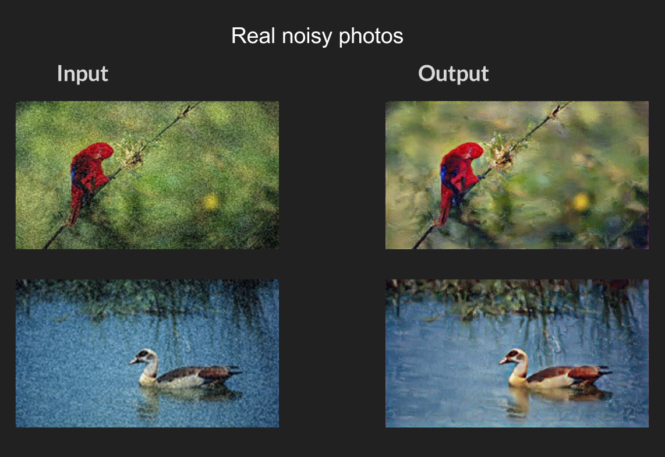
Result:(contd..)

Slide 17
Reference:
https://github.com/manumathewthomas/ImageDenoisingGAN?tab=readme-ov-file#dataset
https://github.com/manumathewthomas/ImageDenoisingGAN/blob/master/main.py
https://github.com/manumathewthomas/ImageDenoisingGAN/blob/master/model.py
https://github.com/manumathewthomas/ImageDenoisingGAN/blob/master/test.py
https://github.com/manumathewthomas/ImageDenoisingGAN/blob/master/train.py
https://github.com/manumathewthomas/ImageDenoisingGAN/blob/master/utils.py

Slide 18
Conclusion:
GAN-based approaches offer a promising avenue for removing unwanted noise from real scene images. Their ability to generate realistic and visually appealing denoised images, while preserving important details, makes them a valuable tool for various image processing applications, including photography, medical imaging, surveillance, and remote sensing.

Slide 19
Thank You

